Slide 1

Fiscal Year 2024 Omnibus Budget
Proposed Operating and Capital Budgets
Finance Committee Presentation to Select Board
March 6, 2023

Slide 2
Agenda
Finance Committee Mission & Strategy
Town Manager Act and the Budget Process
FY24 Budget Environment
Proposed FY24 Operating Budget
Proposed FY24 Budget and 5-Year Capital Plan
Finance Committee Recommendations

Slide 3
Mission and Strategy
Mission: define a financial strategy for the Town and to use as basis for recommending a fiscally responsible operating and capital budget to Annual Town Meeting
Strategy: balance the demand for services, by a community with multiple needs and desires, with the ability of residents with a broad range of financial situations to afford those services

Slide 4
Town Manager Act and Budget Process
Inaugural year Implementing Town Manager Act, which changes Budget Process
Goal of a more Streamlined Process
Town Manager:
    Sets Budget Guidelines (with FinCom Recommendations)
    Reviews all Department budgets (including Schools)
    Makes adjustments to make a balanced budget
    Presents Proposed Omnibus Budget to Finance Committee
Finance Committee
    Reviews Omnibus Budget from Town Manager
    Makes adjustments to make a balanced budget
    Presents Omnibus Budget to Town Meeting

Slide 5
FY24 Budget Environment
Challenges Facing FY24 Budget and Beyond:
  Approaching Prop 2 ½ Overrides in FY25 or FY26 as Levy Cushion Depletes
  Ubiquitous Inflation
  Collective Bargaining Agreements (most Town/Teachers’ unions)
  Increased Debt Service from $21M Debt Issued in 10/22 (incl. COA-CC and Loker Field Voted at 2022 ATM)
  ARPA Funds Availability to Offset some Capital Budget Items
  Near-term Need to Address Water Infrastructure – Significant Capital Investment

Slide 6
FinCom Operating Budget:
Budget Drivers
Town
  Settlement of 3-yr old Fire Contract, MOU with AFSCME
Schools
  $1.74M increase in Special Education
    up 48%YOY to $5.4M
    approx. $390K due to DESE-agreed 14% increase in Out of District Tuition for Special Ed.
  Addition of 3FTEs for The Children’s Way ($181K)
Unclassified
  $1.75M Increase in Debt Service due to increase in ’22issued debt (incl 22 ATM-Voted COA-CC and Loker field)
  Transition of Utilities Budget line to Unclassified from Department Lines
Use of Free Cash to fund Road Repairs
Use of Closeouts to fund Capital expenditures (closed 28 projects; 159 remain open)
Consideration of other Gift/RE Funds to Reduce Tax

Slide 7
FY24 Operating Budget w/ Adjustments
(Guideline of 4.5% Year-over-Year Increase for each Department)

Slide 8
FY24 Operating Budget: Revenue / Adjustments
Revenue Enhancement Ideas – Real estate/Gift funds to offset Tax Burden – under consideration

Slide 9
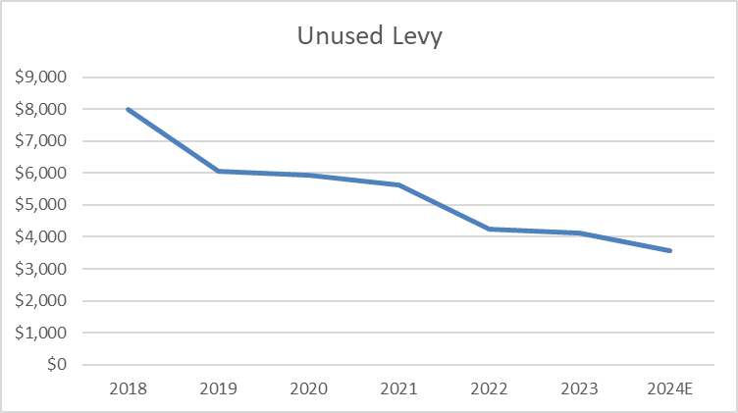
Prop 2 ½ Levy Capacity
‘24 Est (at 2/27/23)
‘24 Est (at 12/30/22)
Notes:
From approx. $0.5MM excess capacity to over $3.5MM
$1..8 M reductions in budget (TM and FC cuts)
($0.2M) increase in Afsme/Fire
$0.3M lower than exp. H/Ccosts
$0.7M use of FC (inst. Cash/Tax) for Roads
$1.2M more in State Aid than expected

Slide 10
FY24 Capital Budget
Recommended Capital | FY24 | Guideline
Cash Capital (CC) Taxation in Current Year | $0 | $600-800K
Free Cash (FC) No Impact on Tax Levy | $1,764,291 | $1.5-2.0M
Capital Close-outs No Impact on Tax Levy | $1,389,081 | No GL
Non-exempt Debt (LD) Taxation - payments spread over up to 20 years | $0 | $3.0-5.0M
Exempt Debt (ED) Taxation-payments spread over up to 20 years not subj. to Prop 2 ½ | $0 | No GL
Ambulance Receipts (AMB) No Impact on Tax Levy | $288,000 | $200K
Water Debt No Impact on Tax Levy – Impact on customers | $1,876,000
Water Certified Retained Earnings | $139,000
Total | $5,456,372

Slide 11
FY24 Capital Budget Projects

Slide 12


5-Year Capital Plan
Does not include plan for Water infrastructure expense as plan is yet TBD.
vs. $69.4M last year

Slide 13
Recommendations
Consider Real Estate-Gift Funds to Offset Debt or Debt Service for Large Capital Projects
Encourage Most Efficient Investment of Town Assets, including Debt Proceeds (Cash)
Consider Inter-Municipal with other Towns - Utilities/Other Purchases
Consider Medicare Buy-In for Retirees
Formulate Strategic Long-Term Plan for OPEB Spending
Evaluate Hiring Practices to Mitigate Financial implications (Settlements)
Long-term Strategic Plan - Water Infrastructure/MWRA, Other Infrastructure
Study Transfer Station Viability
Review Town Operations/Processes (adhoc committee/working group) for efficiencies

Slide 14
Recommendations-Continued
Closely Manage Capital Projects
Institute 5-year Pro-forma budgeting
Continue to Expand Revenue Sources – Assess Economic Development Opportunities

Slide 15
Questions

