Slide 1
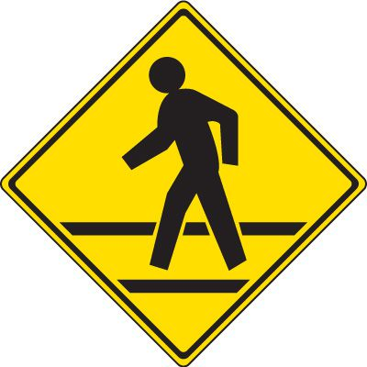
Crosswalk Improvements

Slide 2
Old Connecticut Path @ Charena Road Installed new high visibility double backed signs and arrows with high visibility pole markers.

Slide 3
Old Connecticut Path @ Stonebridge Road Installed new high visibility Double backed signs and arrows. Waiting on high visibility pole markers.

Slide 4
Old Connecticut Path @ Maiden Lane Installed new high visibility double backed signs. Waiting on high visibility pole markers

Slide 5
Pequot Road @ Maiden Lane Installed new high visibility double backed signs. Waiting on High visibility pole markers

Slide 6
Pequot Road @ Juniper Lane Installed new high visibility double backed signs. Waiting on high visibility pole markers.

Slide 7
School Street @ Middle School Path Installed new high visibility double backed signs with actuated flashing lights.

